Slide 1

SeJong
Reservation
A Flight Reservation Project:C#
Software Engineering
SN 6
노하윤 (Noh Ha Yoon)
안정연 (Ahn Jung Yeon)
이선혜 (Lee Seon Hye)
김병준 (King Byung Jun)

Slide 2

CONTENTS
CHAPTER 1
Welcome to
SeJong Reservation
CHAPTER 2
Choose the date
And flight type
CHAPTER 3
Choose your destination
CHAPTER 4
SeJong Reservation
Departure each country

Slide 3
1
Welcome to
SeJong Reservation
Chapter

Slide 4
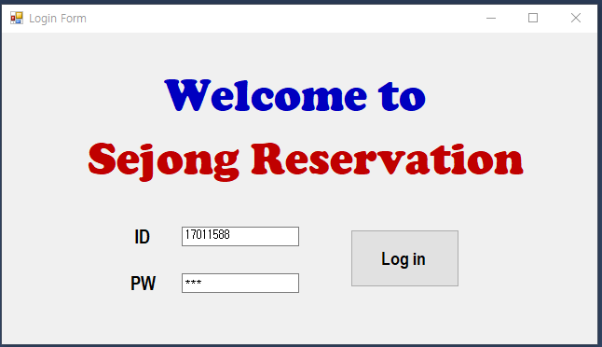
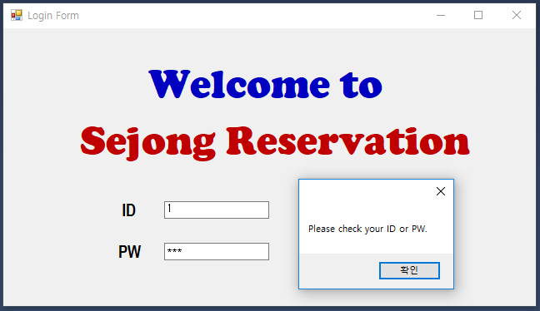


CHAPTER 1 Welcome to SeJong Reservation
When you run the program, you will see the login screen.
1
2
1
First Log in Screen Picture
2
Log in Failure Picture

Slide 5
2
Choose the date
And flight type
Chapter

Slide 6
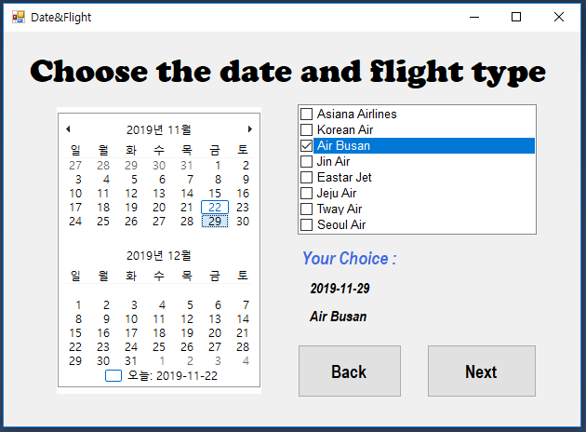
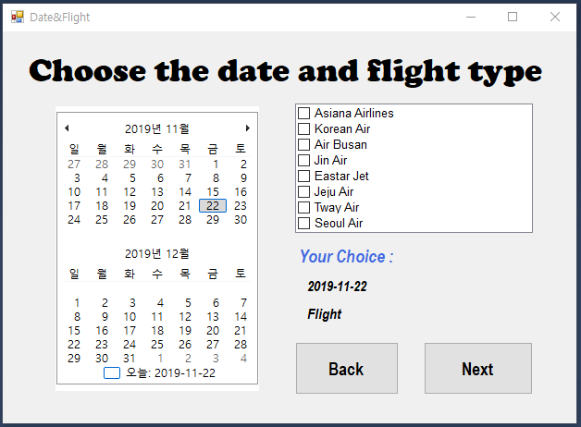
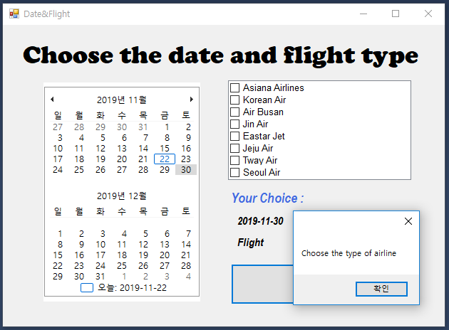
CHAPTER2 Choose the date and flight type
2
If you press the Next button
Without cheking the Airline CheckBox,
The MessageBox will appear.
Choose the date of filght you want.
Date
Failure
1
텍스트
3
텍스트
Airline
텍스트
Choose the airline you want.

Slide 7
3
Choose your
Destination
Chapter

Slide 8
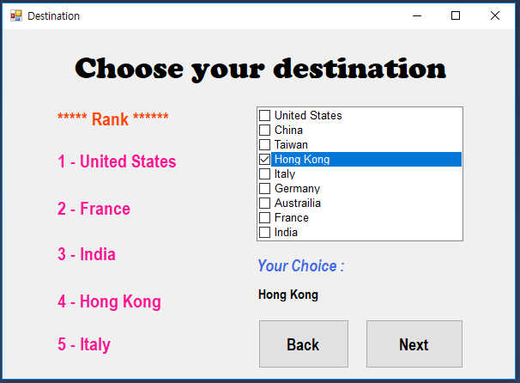


CHAPTER3 Choose your Destination
Choose your destination
(Rank means The popular destination)
The selected destination is displayed
Under ‘Your Choice’
텍스트
텍스트
Next

Slide 9
4
Departure
Each Country
Chapter

Slide 10
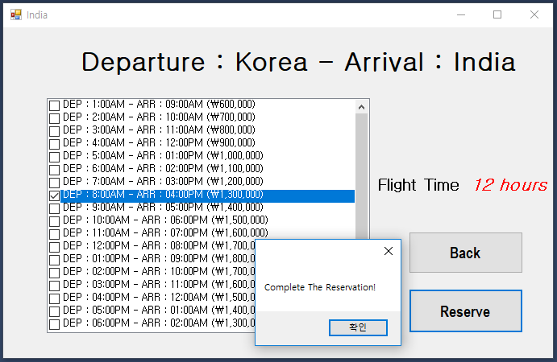
CHAPTER4 Departure Each Country
1
DEP, ARR, PRICE
2
FLIGHT TIME
It shows a list of
DEP times and ARR times
For each country’s
Scheduled flight times.
Show the total
estimated flight time
for convenience
3
RESERVE
4
AIR SEAT
If you press
the Reserve button,
‘Complete The Reservation!’ will be showed.
Air seats are available
On-site.

Slide 11
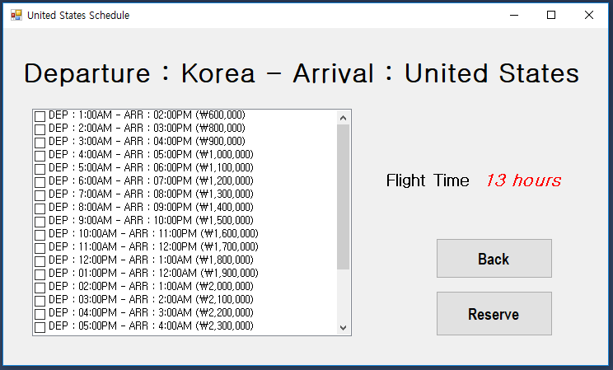
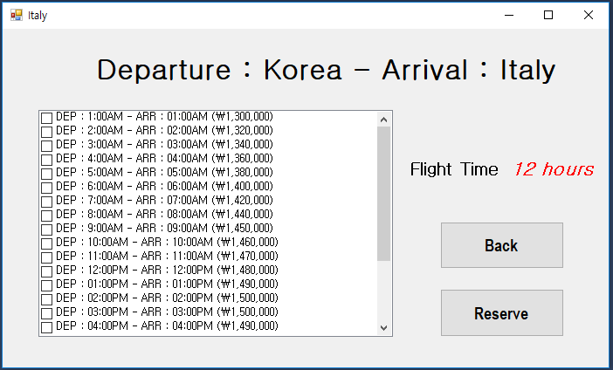
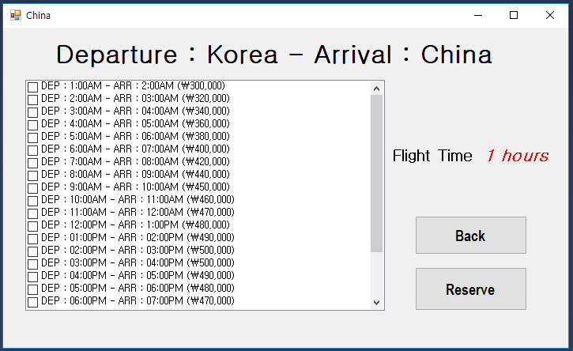
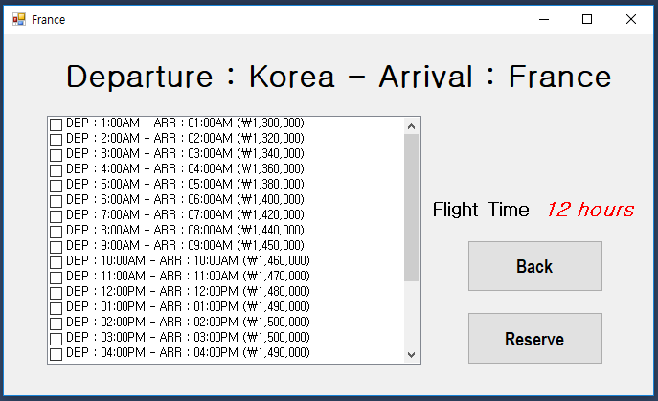
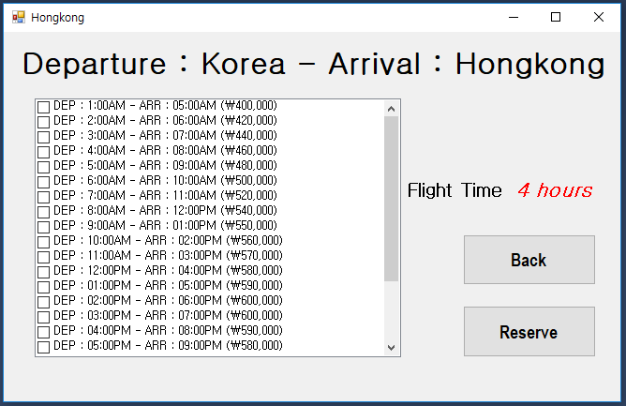
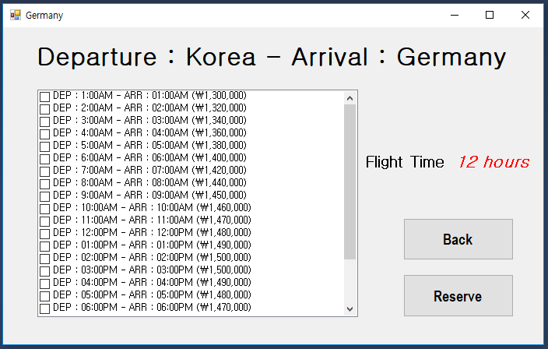
CHAPTER4 Departure Each Country
Departure Info. United States
Departure Info. Italy
Departure Info. China
Departure Info. France
Departure Info. Hong Kong
Departure Info. Germany

Slide 12
Thanks you

